Slide 1
Functions Part 2
Adding Parameters

Slide 2
Parameters
Parameters are special variables that are specific to your function
There are two types of parameters:
  Formal parameters
    Variables that are part of the function signature
  Actual parameters
    Values you assign your variables when you make a function call

Slide 3
Example 1
Create a method called hypotenuse that takes two numbers representing the legs of a right triangle and prints the length of the hypotenuse to the screen

Slide 4
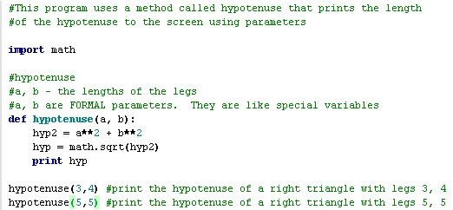

Example 1a

Slide 5
Accessing Parameters
Python allows you to make method calls using two different techniques:
  Positional parameters:
    Parameters are copied in the order they are presented
  Assigned parameters:
    Parameters are assigned values similarly to variable assignment

Slide 6
Example 2: dotbox
The following program draws a sequence of dots to the screen based on the number of rows and columns specified in the method signature

Slide 7
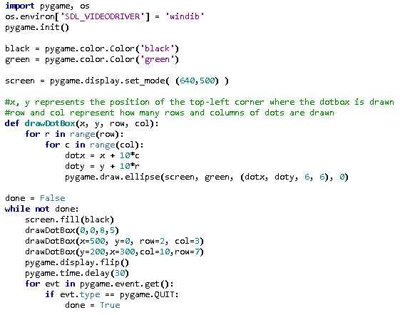
Example 2

Slide 8
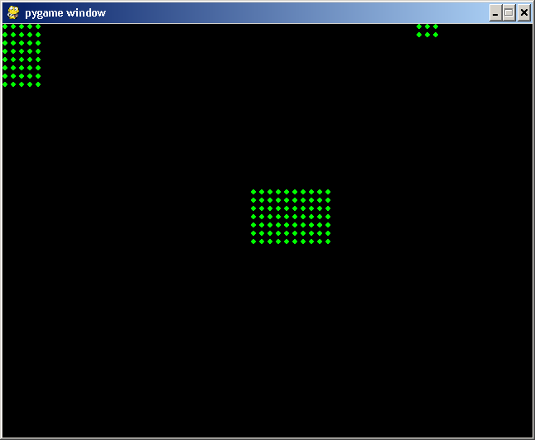
Example 2

